Slide 1
ASP.NET CORE, PEEK INTO THE FUTURE
By Expert Network
@FII Practic

Slide 2
Recap

Slide 3
RAZOR
Razor is a markup syntax for embedding service-based code into web pages.
Consists of Razor markup, C#, and HTML.
Files containing Razor generally have a .cshtml file extension.

Slide 4
RAZOR CODE BLOCKS
@{
var quote = "The future depends on what you do today";
}
<p>@quote</p>
@{
var quote = "Hate cannot drive out hate, only love can do that.";
}
<p>@quote</p>
--> Renders:
<p>The future depends on what you do today.</p>
<p>Hate cannot drive out hate, only love can do that. </p>

Slide 5
RAZOR CAN DO MORE
Looping @for, @foreach, @while, and @do while
Conditionals @if, else if, else, and @switch
@try, catch, finally
@using directive
@model LoginViewModel (model passed to a view)
@Model.Username / @Model.Password

Slide 6
WHEN SHOULD I REBUILD?
Rebuild the project if you modify .cs files.
Rebuilding is NOT necessary when modifying Razor files (.cshtml), CSS, HTML, JS.

Slide 7
LAYOUT
Most web apps have a common layout that provides the user with a consistent experience as they navigate from page to page.
The layout typically includes common user interface elements such as the app header, navigation or menu elements, and footer.

Slide 8
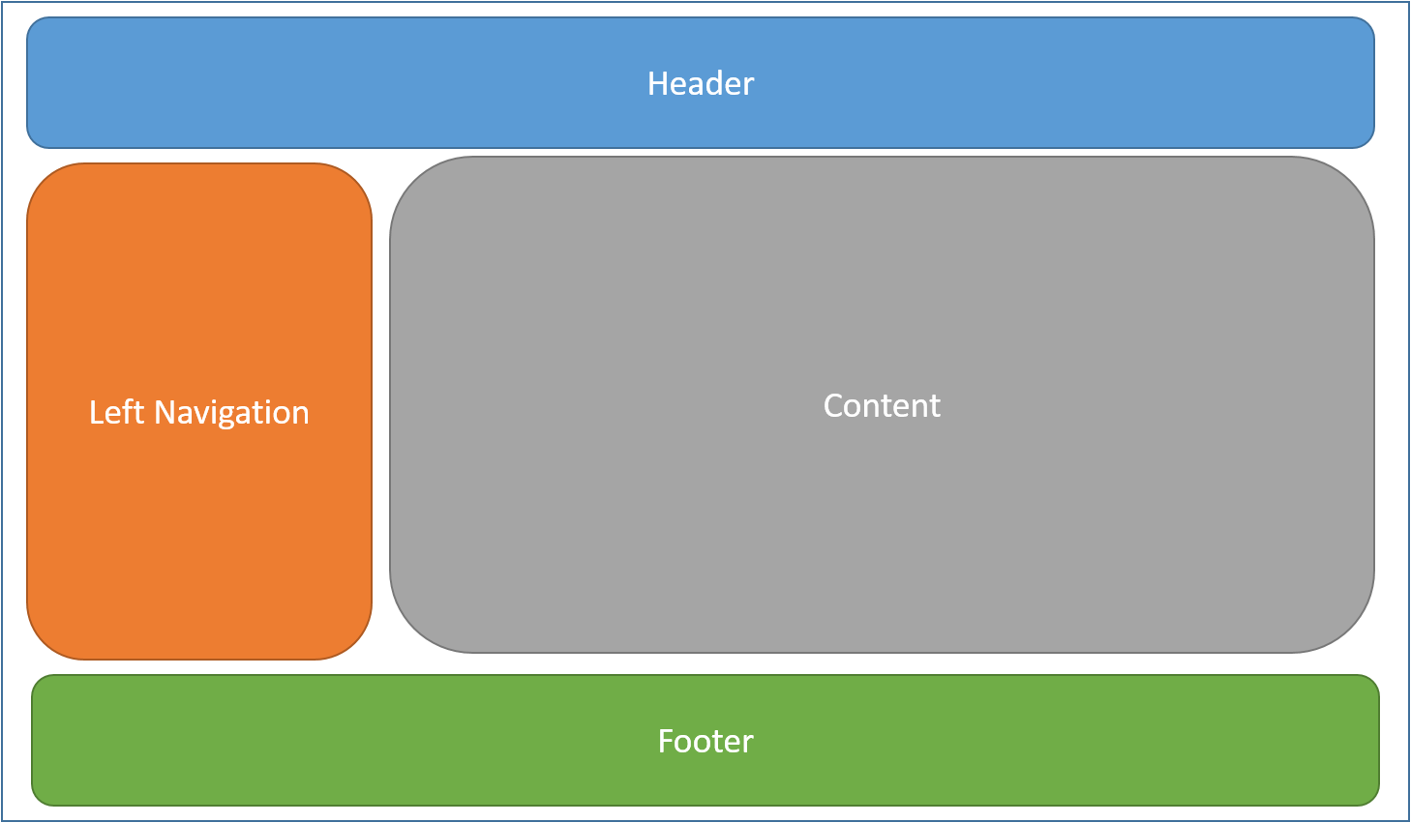
LAYOUT

Slide 9
GOOD PLACE FOR JS AND CSS
Common HTML structures such as scripts and stylesheets are also frequently used by many pages within an app.
All of these shared elements may be defined in a layout file, which can then be referenced by any view used within the app.
Layout reduce duplicate code in views.

Slide 10
LAYOUT CONVENTION
By convention, the default layout for an ASP.NET Core app is named _Layout.cshtml and is situated in Views/Shared folder.

Slide 11
LAYOUT EXAMPLES (ideas???)

Slide 12
SPECIFY LAYOUT IN VIEWS
At the top of the razor file:
@{
Layout = "_Layout";
}

Slide 13
SPECIFY LAYOUT IN VIEWS
Not needed if we specify the layout inside _ViewStart.cshtml.

Slide 14
NO LAYOUT IN VIEW
@{
Layout = null;
}
When do we need this?

Slide 15
PARTIAL VIEWS

Slide 17
RAZOR HELPERS

Slide 18
COMPARISON
Razor syntax
Tag Helper syntax
@using (Html.BeginForm())
{
<div>
@Html.LabelFor(m => p.Name, "Name:")
@Html.TextBoxFor(m => p.Name)
</div>
<input type="submit" value="Create" />
}
<form asp-controller="Products" asp-action="Create" method="post">
<div>
<label asp-for="Name">Name:</label>
<input asp-for="Name" />
</div>
<input type="submit" value="Save" />
</form>

Slide 19
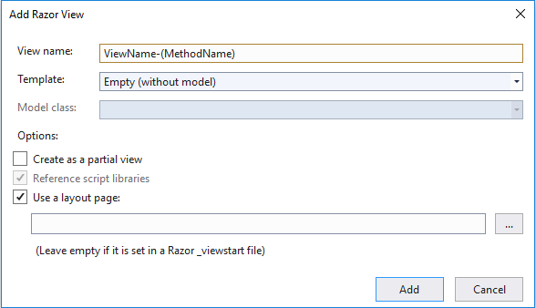
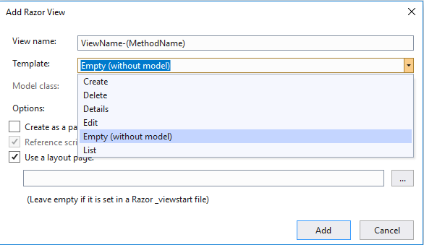
Scaffolding

Slide 20
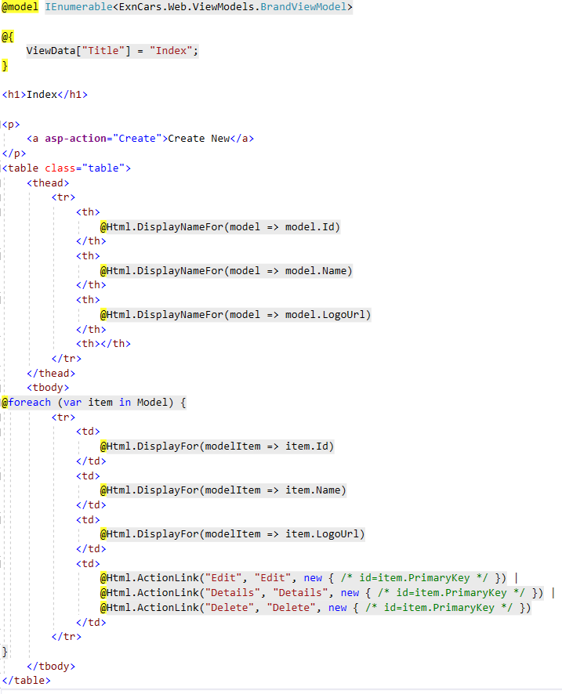
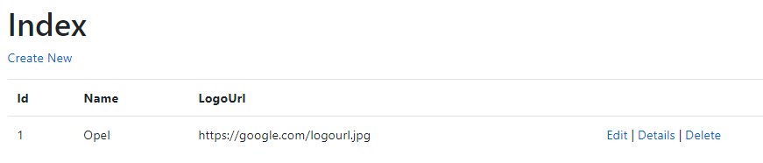
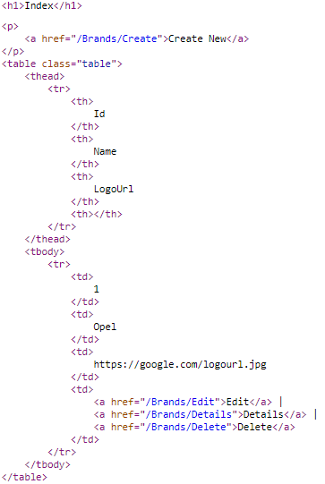

Slide 21
Scaffolding demo

Slide 22
Let’s wire up DI into our web projects

Slide 23
CRUDs :)

Slide 24
Validation

Slide 25
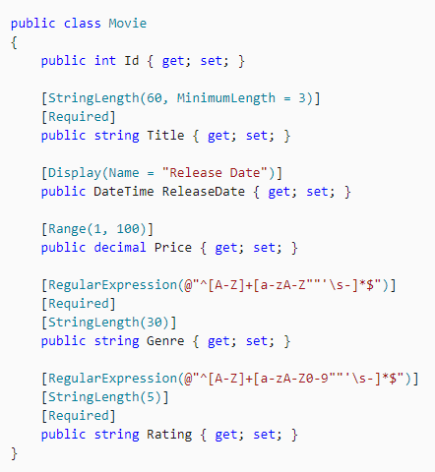
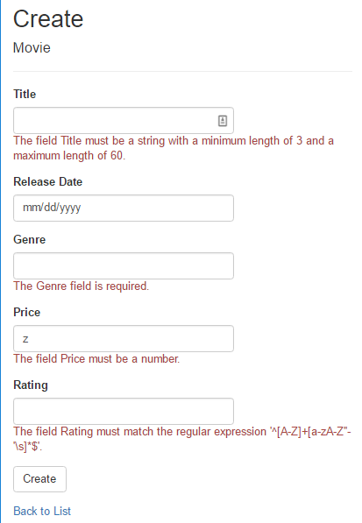

Slide 26

Frontend validation
If you add this block of your code to your view
It will generate the following html
Which will add jquery validation to your page

Slide 27
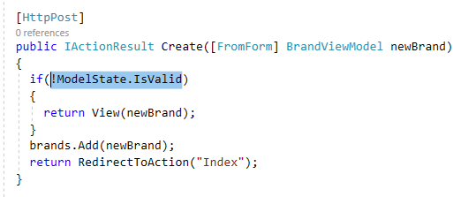
Backend validation

Slide 28
Validation demo

Slide 29
JQUERY

Slide 30
THE MOST USED JS LIBRARY
Makes working with DOM easier

Slide 31
COMPARISON
Javascript
JQuery
var elements = document.getElementsByClassName(“link”);
var i;
for(I = 0; i< elements.length; i++){
elements[i].className = elements[i].className + “ selected”;
}
$(‘.link’).addClass(“selected”)

Slide 32
EQUIVALENTS
Javascript
JQuery
document.getElementsByClassName(“class”);
document.getElementsById(“id”);
$(‘.link’);
$(‘#id’)

Slide 33
AJAX

Slide 34
AJAX
Client-side script that communicates to and from a server without the need for a postback or a complete page refresh.
(The method of exchanging data with a server, and updating parts of a web page – without reloading the entire page.)

Slide 35
AJAX
Asynchronous – Allows you to make asynchronous calls to a web server. This allows the client browser to avoid waiting for all data to arrive before allowing the user to act once more.
User-Friendly – Because a page postback is being eliminated, AJAX enabled applications will always be more responsive, faster and more user-friendly.
Increased Speed – Send and receive only the needed data (XML/JSON w/out HTML for example).

Slide 36
AJAX STRUCTURE
$.ajax({
url: url, //String -> A string containing the URL to which the request is sent.
data: data, //PlainObject || String -> Data that is sent to the server with the request.
success: success, //Function -> A callback function that is executed if the request succeeds.
dataType: dataType //String -> type of data expected from server. Default: Intelligent Guess.
});

Slide 37
BASIC AJAX EXAMPLE
@section Scripts{
<script>
$(document).ready(function () {
$("footer").on('click',
function () {
$.ajax({
url: '@Url.Action("AllBrands", "Brands")',
success: function (data) {
debugger;
console.log(data);
}
})
});
})
</script>
}

Slide 38
What should we do next?

